Slide 1

2025 TaiESM1 Tutorial
梁信謙 (Hsin-Chien Liang)
AC3/RCEC, Academia Sinica
2025-08-13-14 @ RCEC/Academia Sinica

Slide 2
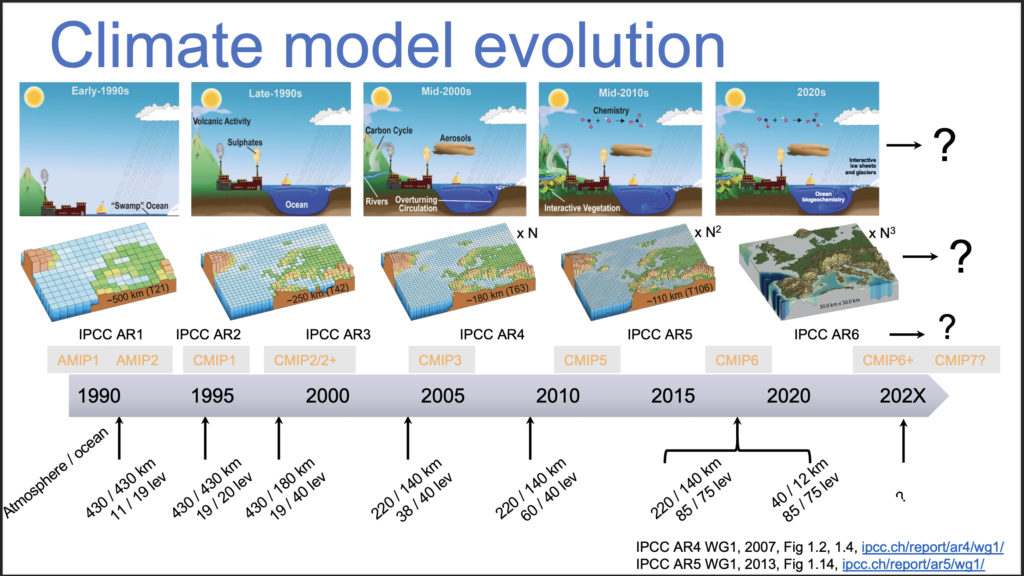

Slide 3
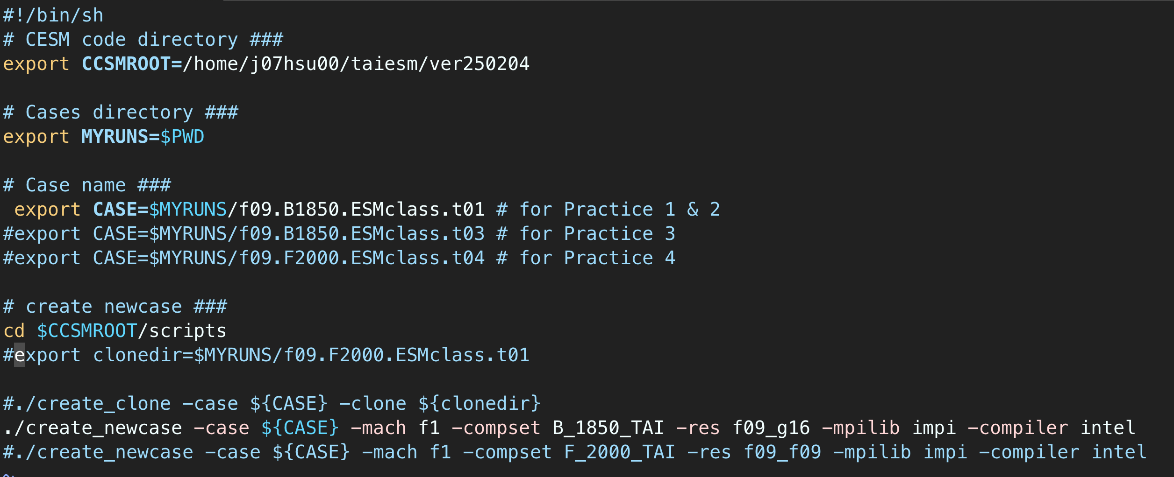
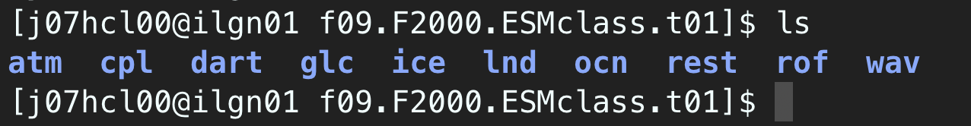
Basic Work Flow
Create taiesm_work directory (mkdir –p /work/username/taiesm_work)
Create a New Case
Configure the Case
Build the Executable
Run the Model : Initial Run and Output Data Flow
./create_newcase -case ${CASE} -mach f1 -compset B_1850_TAI -res f09_g16 -mpilib impi -compiler intel
cesm_setup -> f09.B1800.ESMclass.t01.build-> f09.B1800.ESMclass.t01.submit
可以直接複製 /work1/j07hcl00/taiesm_work/run_taiesm1_example.sh
到 /work1/{帳號}/taiesm_work 底下
接著執行，再按照步驟做可以了
模式輸出將會放在
/work1/{帳號}/taiesm_work/archive/f09.B1800.ESMclass.t01
看看rest裡面有沒有
0001-01-06-00000 這個資料夾

Slide 4
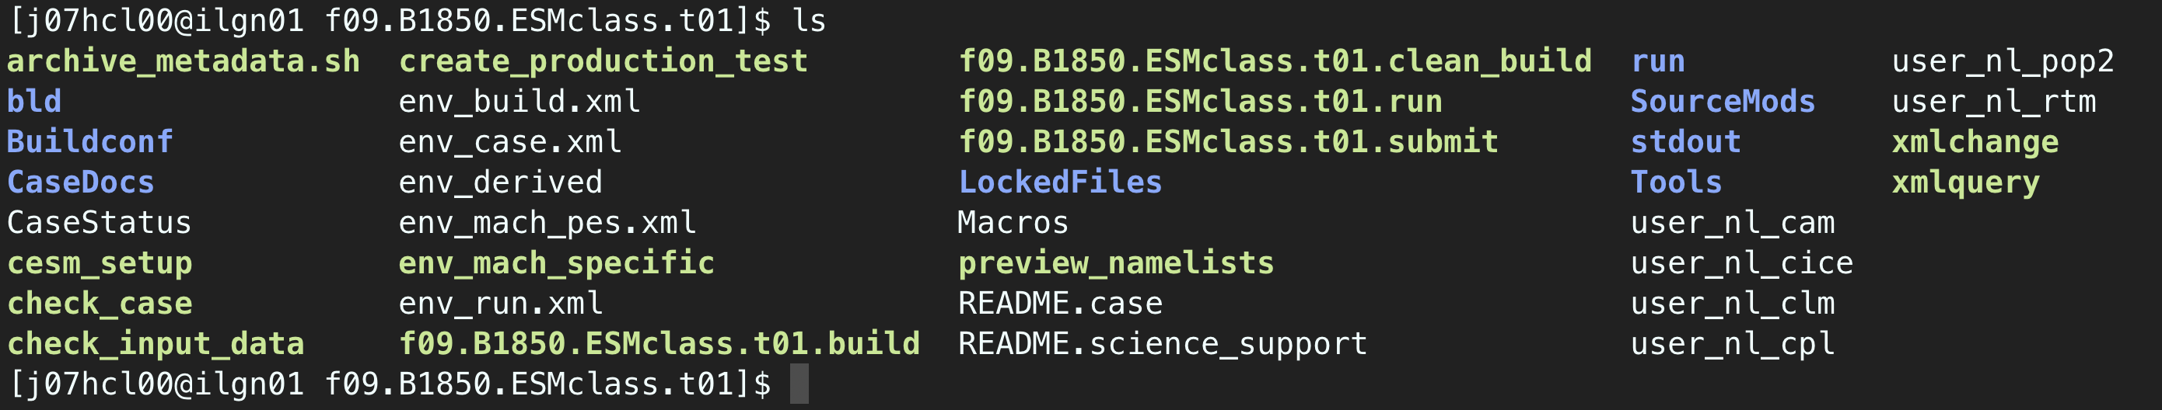
課堂練習二 更改模擬長度 以及 製作系集成員 (Ensemble Member)
pertlim = 1.d-14
pertlim = 2.d-14
pertlim = 3.d-14
pertlim = 4.d-14
pertlim = 5.d-14
pertlim = 6.d-14
pertlim = 7.d-14
pertlim = 8.d-14
pertlim = 9.d-14
pertlim = 10.d-14
pertlim = 11.d-14
pertlim = 12.d-14
pertlim = 13.d-14
pertlim = 14.d-14
pertlim = 15.d-14
pertlim = 16.d-14
pertlim = 17.d-14
pertlim = 18.d-14
pertlim = 19.d-14
pertlim = 20.d-14
pertlim = 21.d-14
pertlim = 22.d-14
pertlim = 23.d-14
pertlim = 24.d-14
pertlim = 25.d-14
……
更改模擬時間長度為一年 (以下方法二擇一)
使用vi
vi env_run.xml
STOP_OPTION 從ndays改為’nyears' ; STOP_N 從5改為'1’
使用xmlchange
./xmlchange STOP_OPTION=nyears
./xmlchange STOP_N=1
在user_nl_cam 裡面增加一個變數
pertlim = ${value}.d-14
參考 https://pse.is/7znkd3

Slide 5
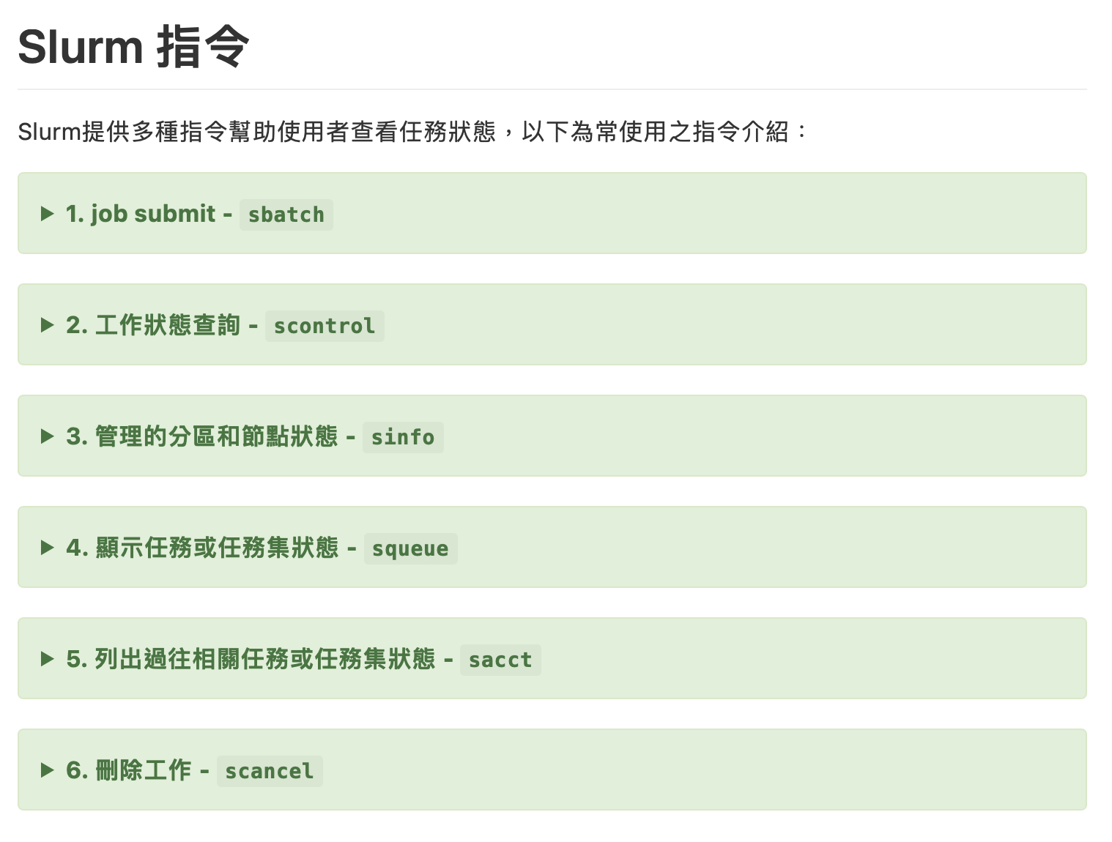
創進一號 (Forerunner I) 排程系統 (Queue System) 介紹
#!/bin/csh -f
# This is a CCSM batch job script
#SBATCH -J f09.F2000.ESMclass.t01
#SBATCH -p development
#SBATCH -n 560
#SBATCH --ntasks-per-node=112
#SBATCH --account=MST113255
#SBATCH -o stdout/%j.out
#SBATCH -e stdout/%j.out
scontrol show job 84242 (job number)
squeue --me

Slide 6
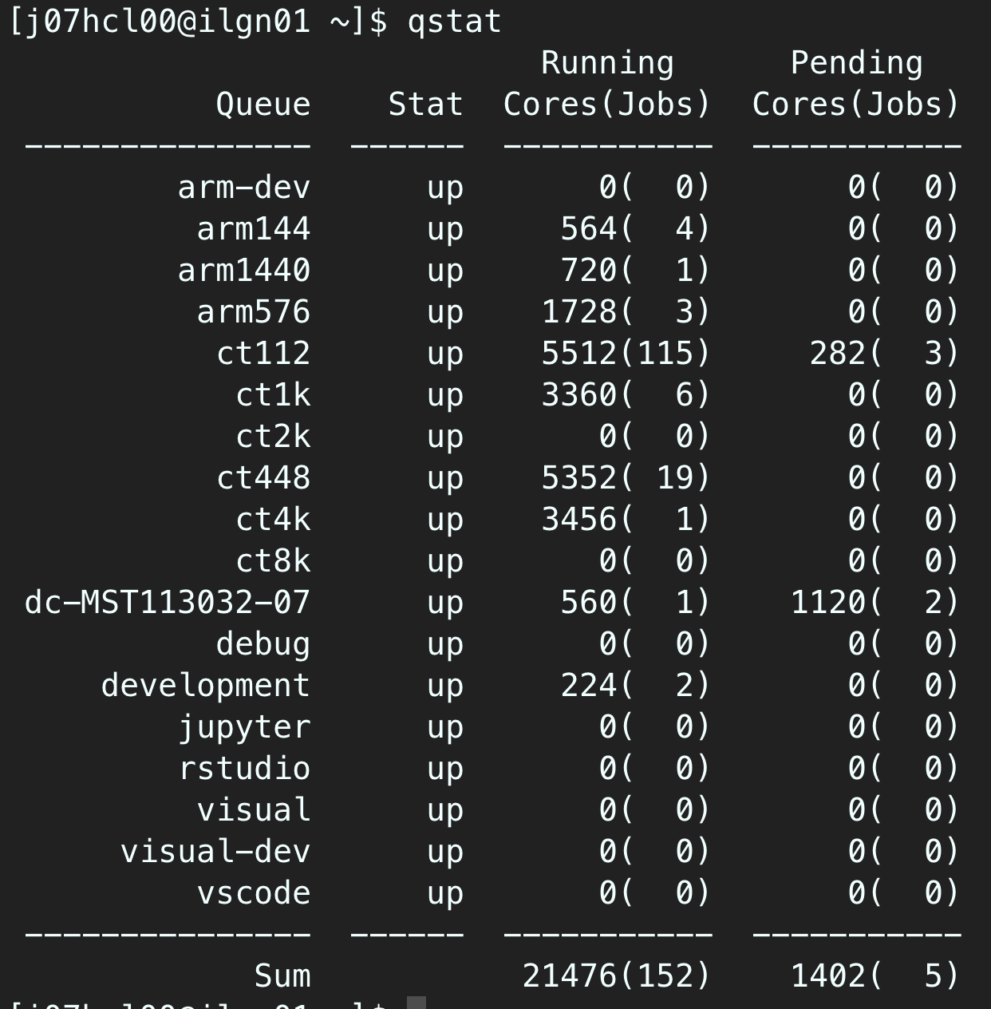
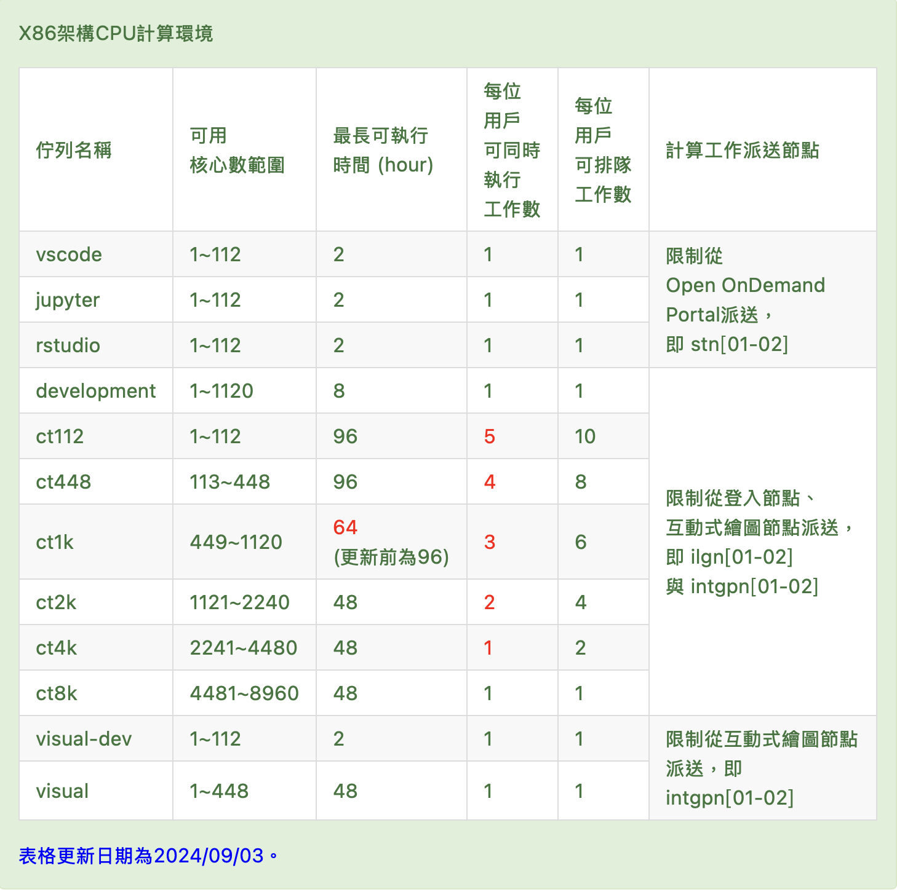

Slide 7
Basic Work Flow
Create a New Case
Configure the Case
Build the Executable
Run the Model : Initial Run and Output Data Flow
REF : https://github.com/lamaliang/TaiESM_ver250204
./create_newcase -case ${CASE} -mach f1 -compset B_1850_TAI -res f09_g16 -mpilib impi -compiler intel
cesm_setup -> f09.B1850.ESMclass.t01.build-> f09.B1850.ESMclass.t01.submit
“case” is the name and location of the case being created • i.e. f09.F2000.ESMclass.t01
“mach” specifies the machine that will be used. • “supported” machines tested regularly, eg. F1 (Forerunner I)
“compset” specifies the “component set” • B indicates fully couple ; F indicates prescribe SST forcing • 2000 indicates fixed emissions for 2000 year climatology.
• F_2000_TAI, F1850-2000_TAI, B_2000_TAI, B_1850_TAI, B1850-2000_TAI
“res” specifies the model resolutions (or grid) • Format is [atm/lnd grid]_[ocn/ice grid] • Equivalent short and long names (f09_f09 == 0.9x1.25 ; f09_g16)

Slide 8
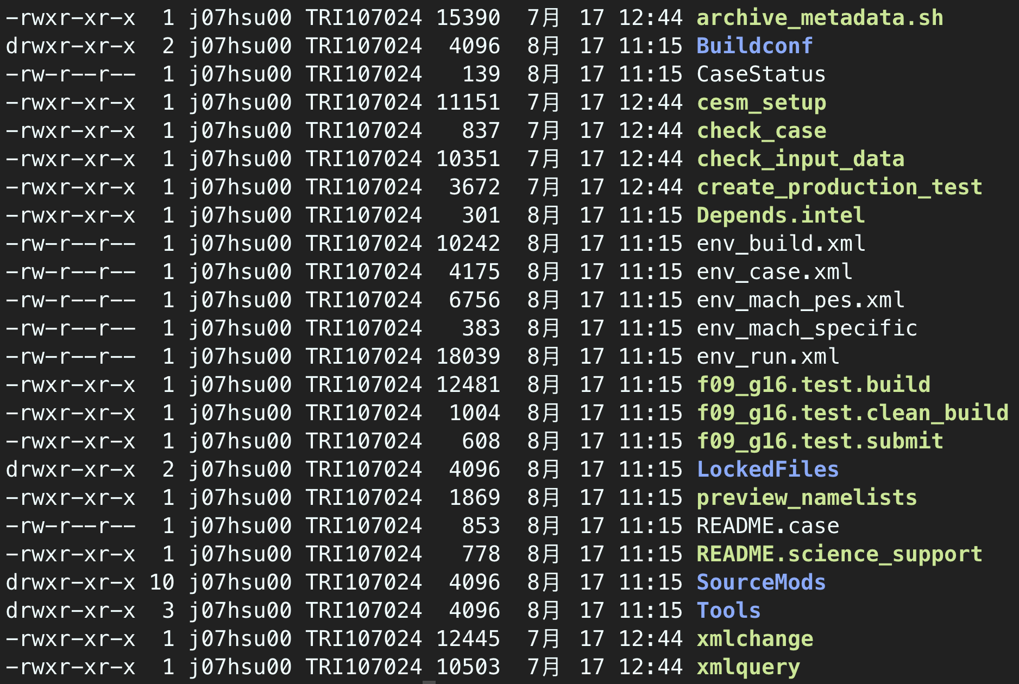
Basic Work Flow
Create a New Case
Configure the Case
Build the Executable
Run the Model : Initial Run and Output Data Flow
execute configure file : ./cesm_setup
clean configure file : ./cesm_setup -clean
configure file
env files
xmlchange

Slide 9
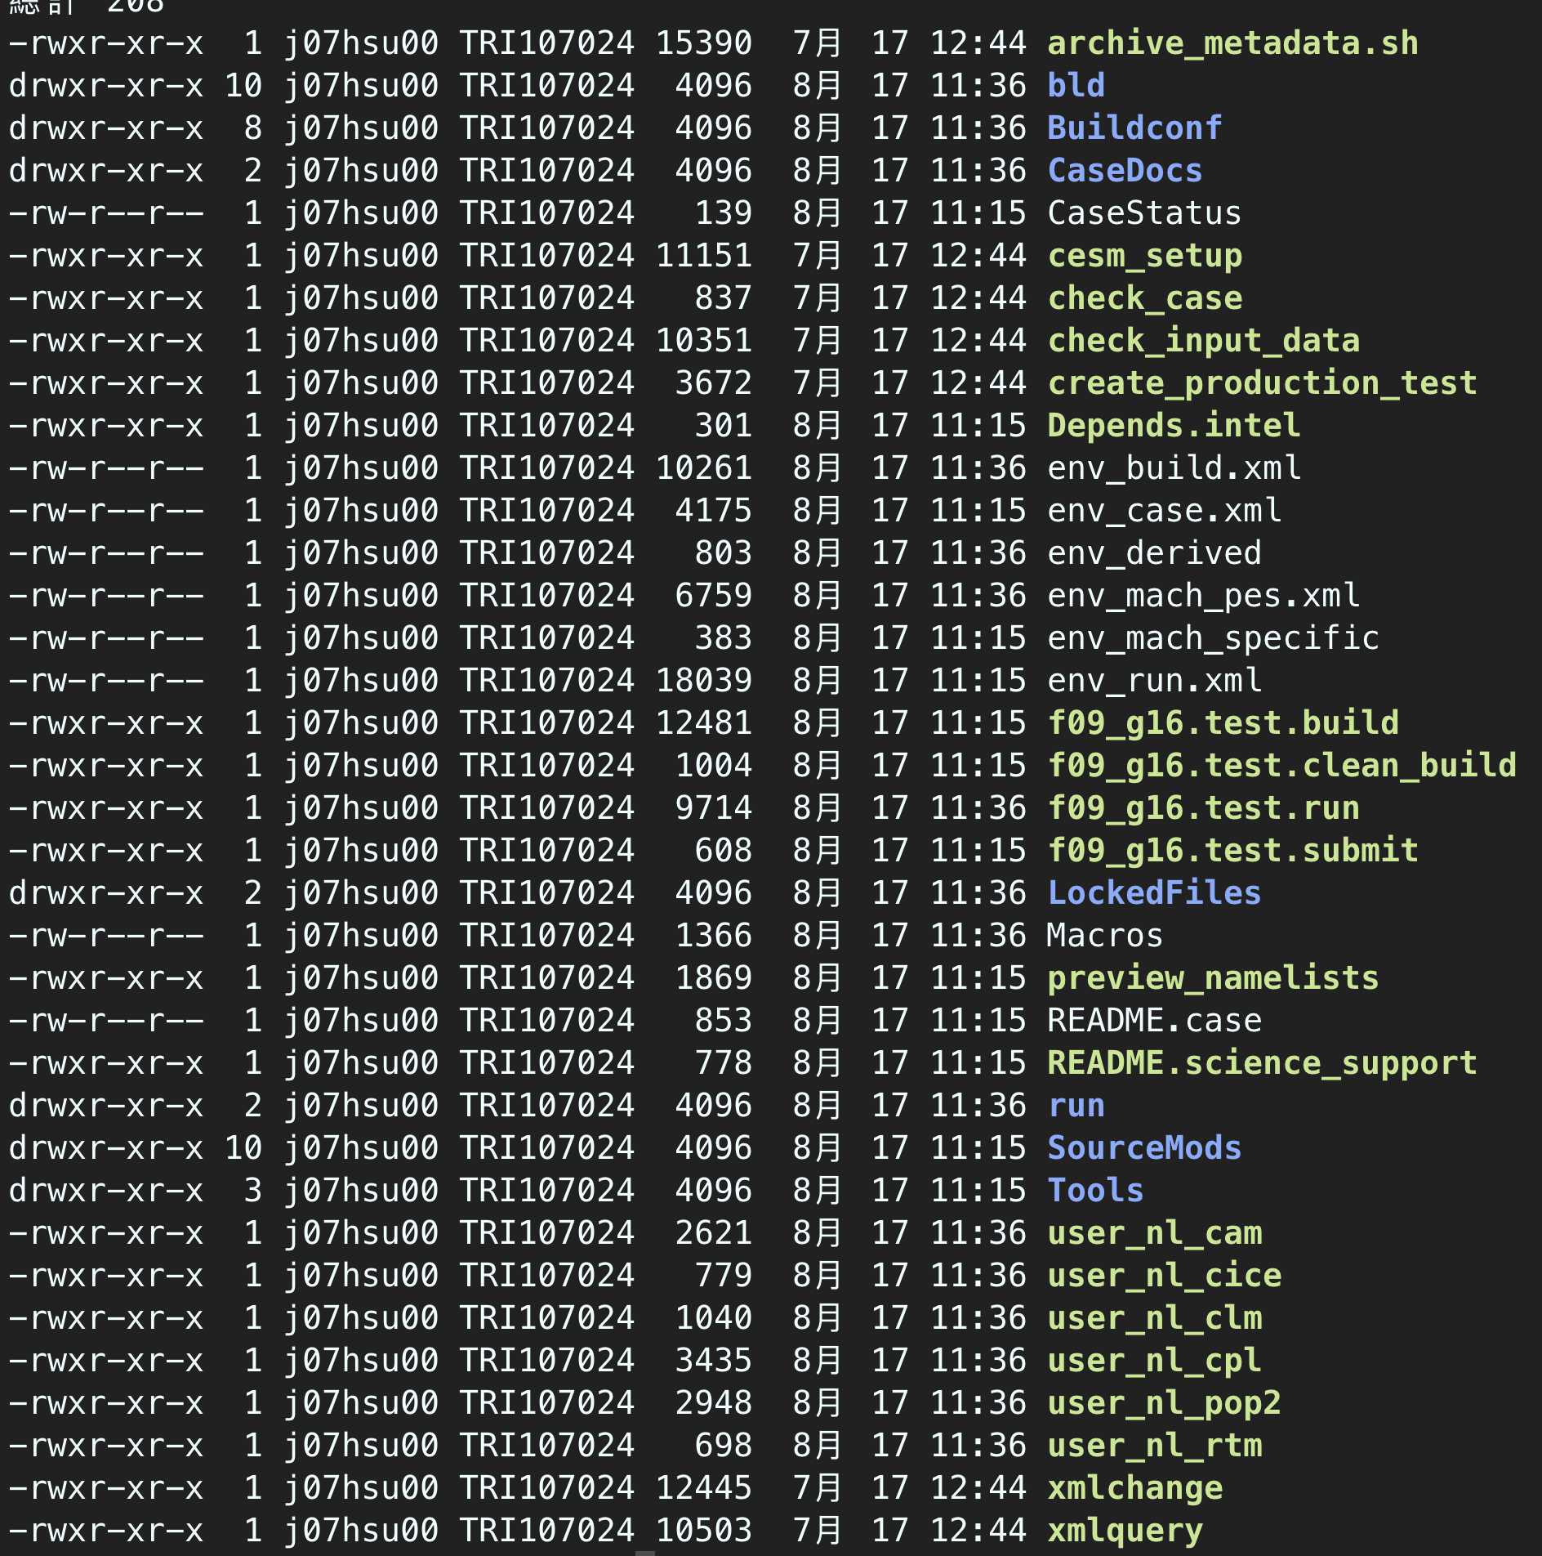
Basic Work Flow
Create a New Case
Configure the Case
Build the Executable
Run the Model : Initial Run and Output Data Flow
execute build file : ./${casename}.run
clean configure file : ./${casename}.clean_build

Slide 10
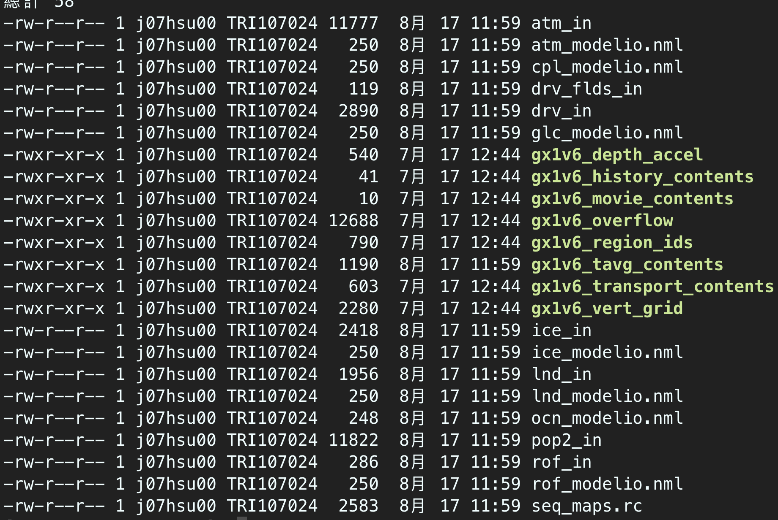
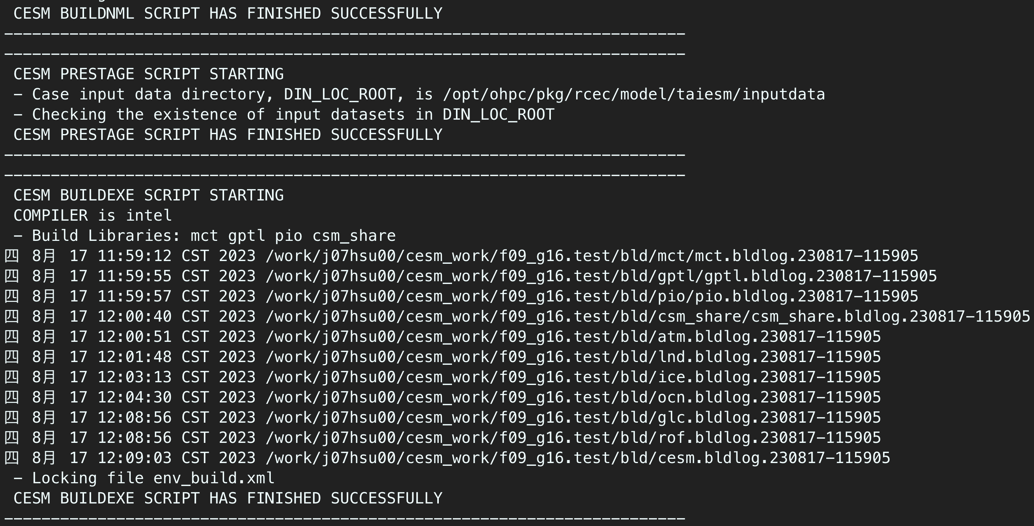
Basic Work Flow
Create a New Case
Configure the Case
Build the Executable
Run the Model : Initial Run and Output Data Flow
execute file : ./${casename}.submit

Slide 11
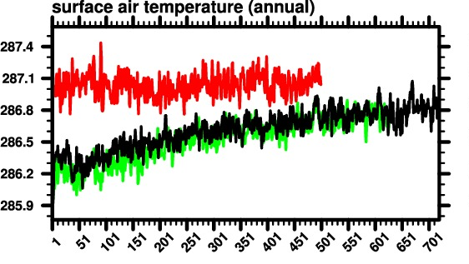
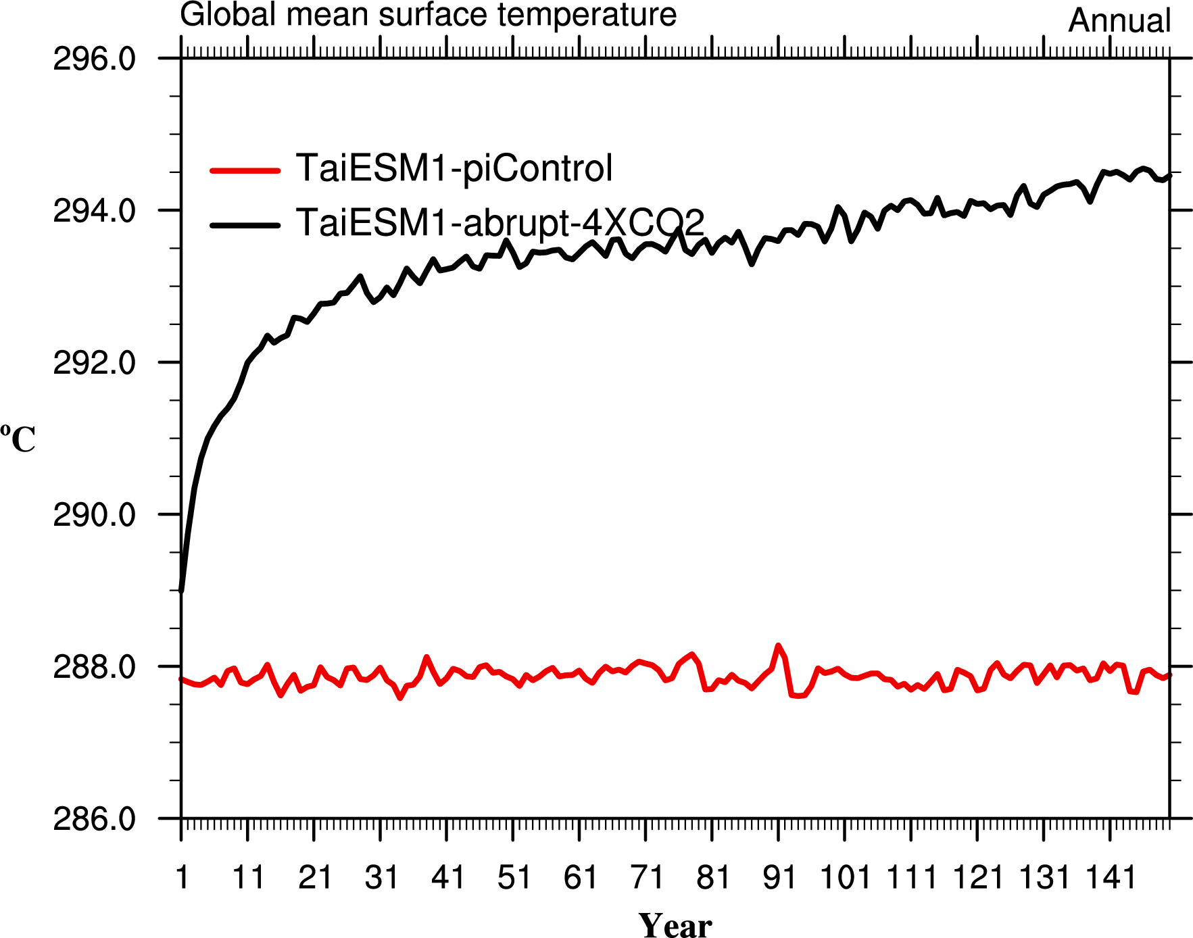
Fully Couple Experiments :
各模式透過coupler做能量交換
Free Run主要是要看模式的interval variability
也可以加入emission 資料，看模式之表現
模式需要長時間積分，才能達到穩定狀態(steady state)，這段期間稱之為spin-up
./create_newcase -case ${CASE} -mach f1 -compset B_1850_TAI -res f09_f09 -mpilib impi -compiler intel

Slide 12
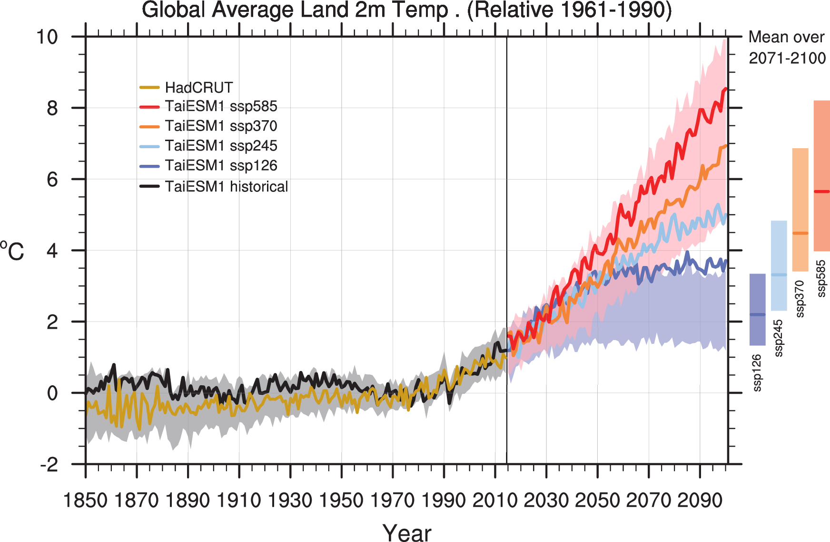
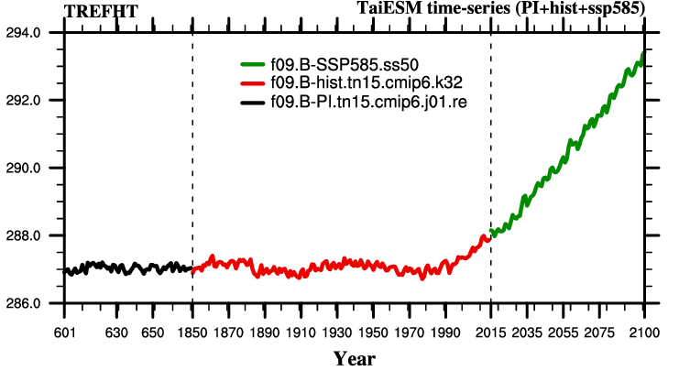
加入隨時間變化之排放(Emission)資料，讓模式可以重現過去氣候狀態
設計不同未來情境，看模式未來之變化
所有實驗都需要一組穩定態的Restart file
模擬emission隨時間變化之實驗(historical or future projection)
./create_newcase -case ${CASE} -mach f1 -compset B_1850-2000_TAI -res f09_g16 -mpilib impi -compiler intel

Slide 13
Fully Couple Experiments :
各模式透過coupler做能量交換
Free Run主要是要看模式的interval variability
也可以加入emission 資料，看模式之表現
模式需要長時間積分，才能達到穩定狀態(steady state)，這段期間稱之為spin-up
./create_newcase -case ${CASE} -mach f1 -compset B_1850_TAI -res f09_f09 -mpilib impi -compiler intel
加入隨時間變化之排放(Emission)資料，讓模式可以重現過去氣候狀態
設計不同未來情境，看模式未來之變化
所有實驗都需要一組穩定態的Restart file
./create_newcase -case ${CASE} -mach f1 -compset B_1850-2000_TAI -res f09_g16 -mpilib impi -compiler intel

Slide 14
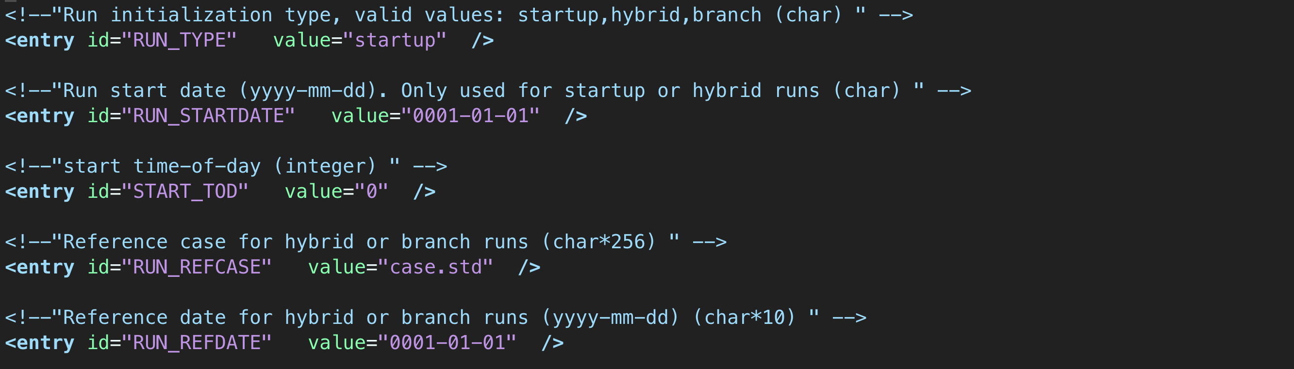
env_run.xml
f09.B-PI.tn15.cmip6.j01.re : 使用 startup 模擬
f09.B-hist.tn15.cmip6.k32 使用hybrid模擬
RUN_STARTDATE = 1850-01-01
RUN_REFCASE = f09.B-PI.tn15.cmip6.j01.re
RUN_REFDATE = 0671-01-01
f09.B-SSP585.ss50 使用hybrid模擬
RUN_STARTDATE = 2015-01-01
RUN_REFCASE = f09.B-hist.tn15.cmip6.k32
RUN_REFDATE = 2015-01-01

Slide 15
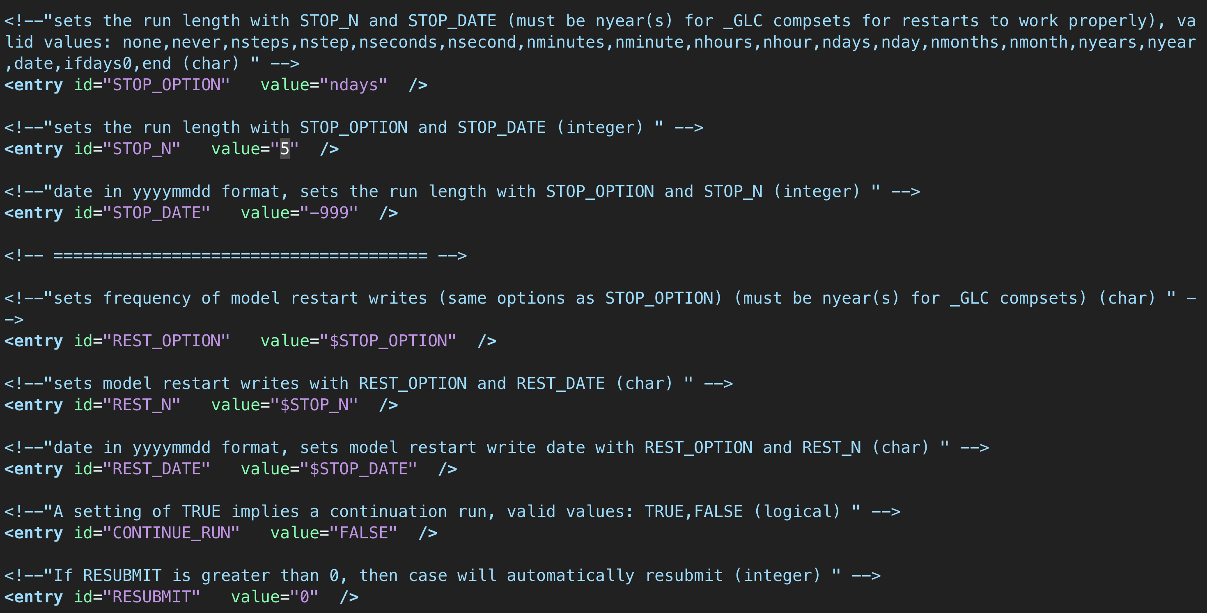

Slide 16
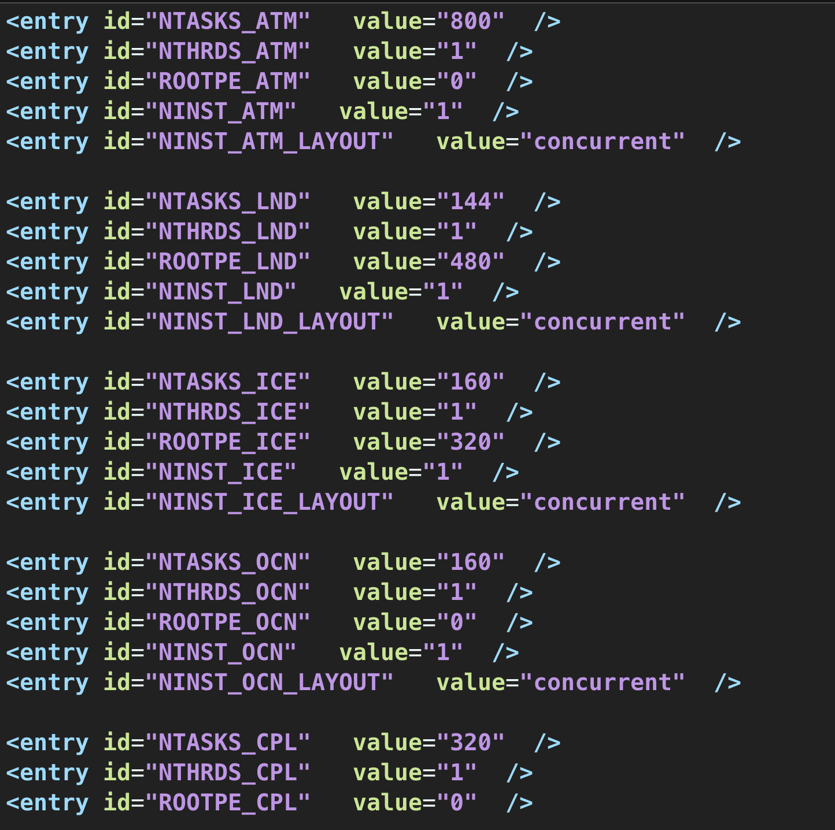
About .xml Files
env_case.xml • Set by create_newcase and cannot be modified
env_conf.xml • Specifies component information • Can change the physics of a model – be very careful about this
env_mach_pes.xml • Specifies layout of components on hardware processors
• Use this to tune
env_build.xml • Specifies build information
env_mach_specific
• Sets modules and paths to libraries (e.g. MPI)
• Can change compiler options, libraries, etc. • Part of porting is to set variables here
env_run.xml • Sets run time information • User interacts with this file most frequently

Slide 17
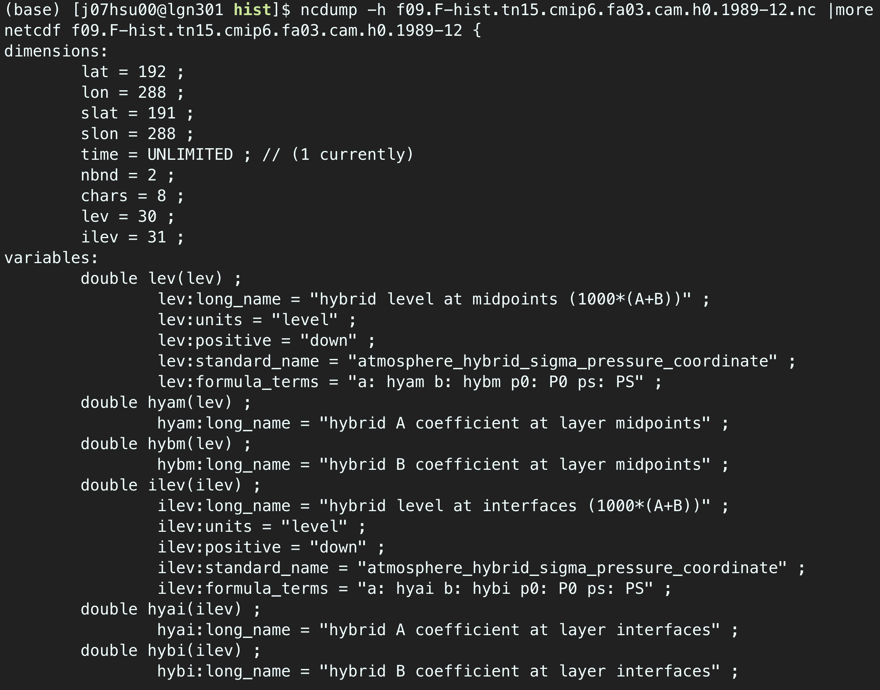
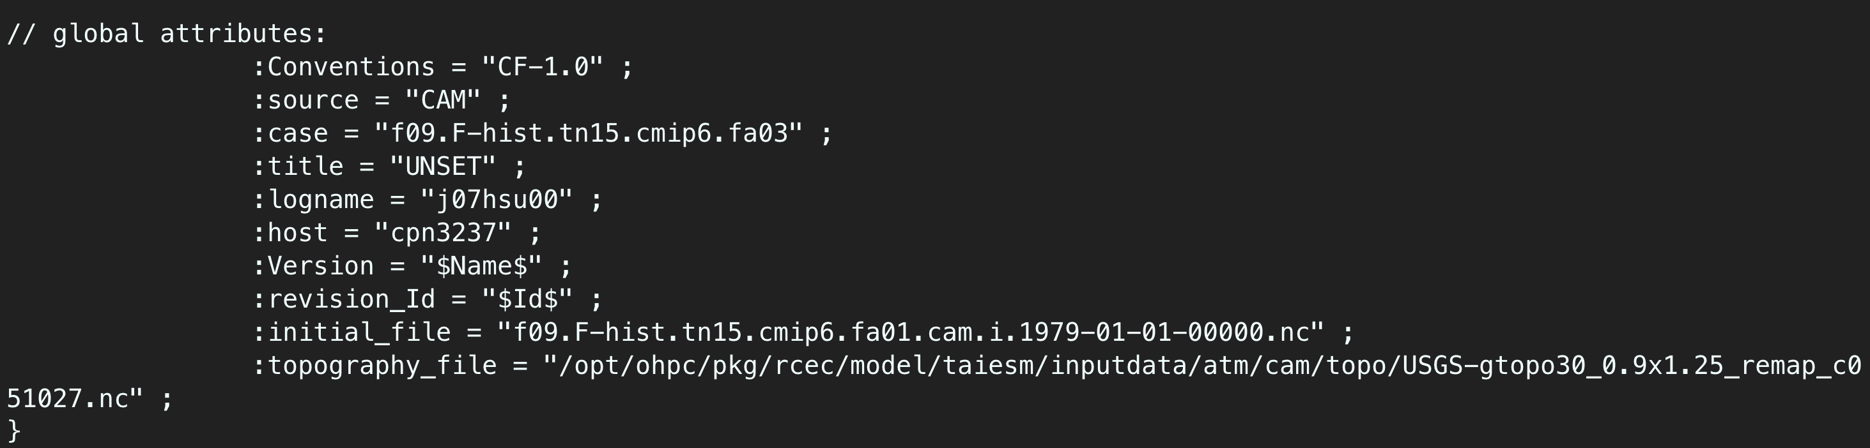
Model output
model output directory
atm
cpl
dart
ice
lnd
ocn
rest
glc
rof
wav
hist
logs

Slide 18
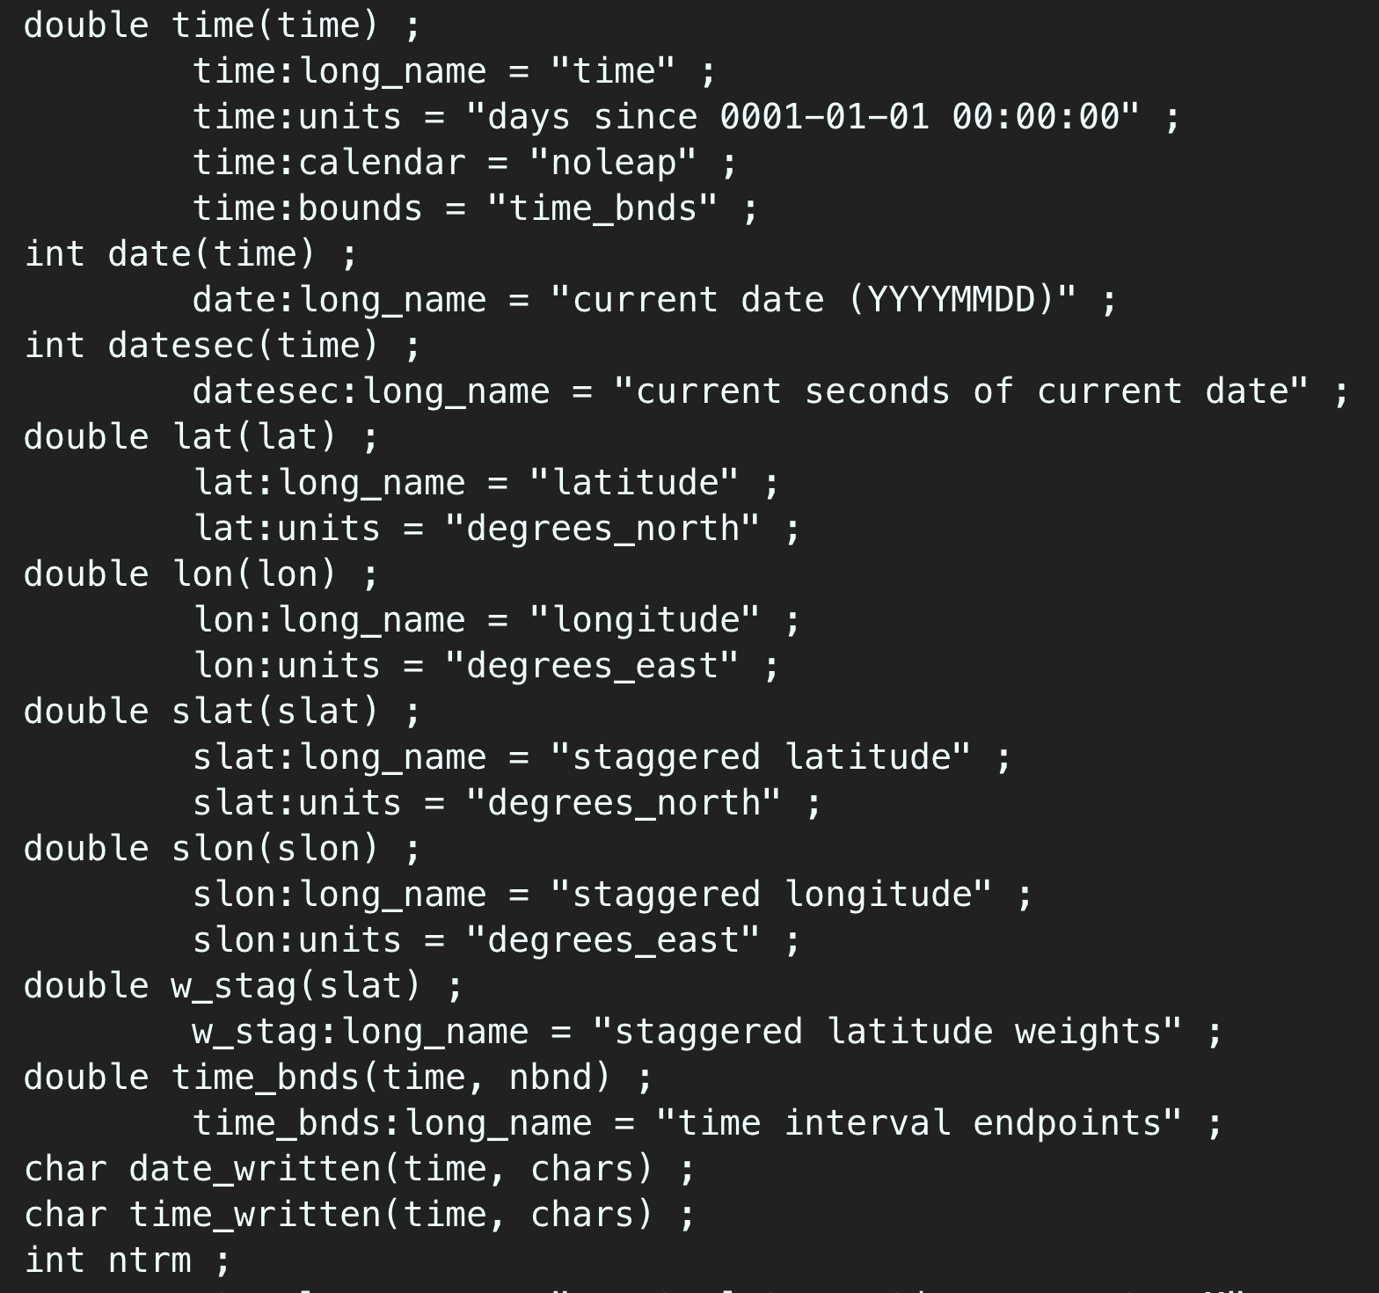
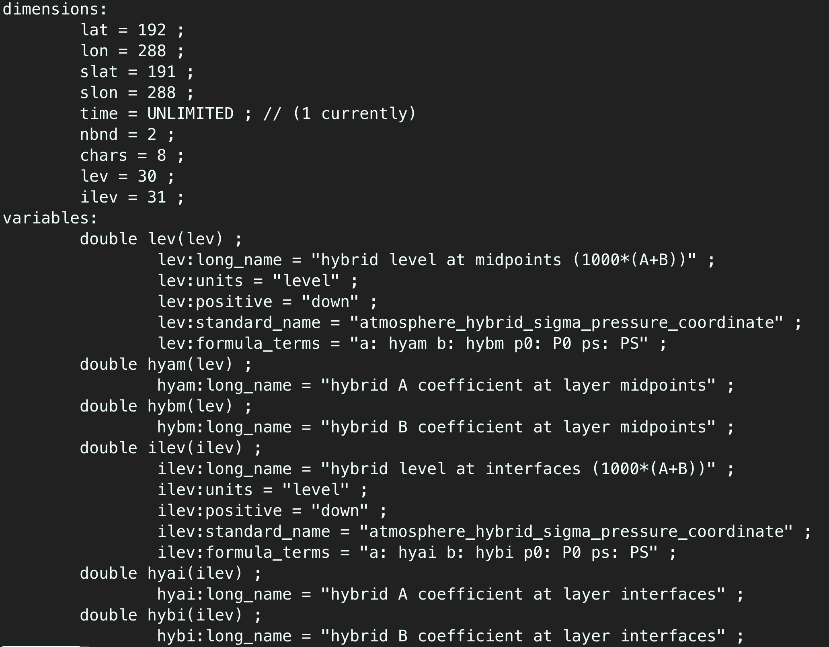
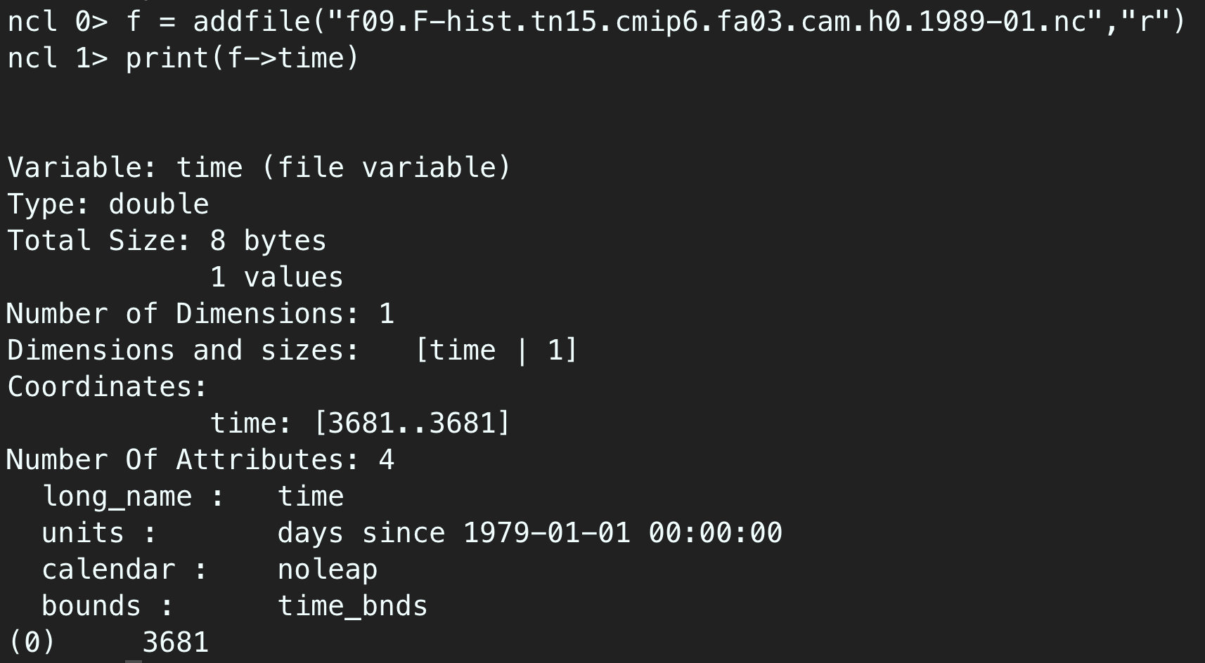
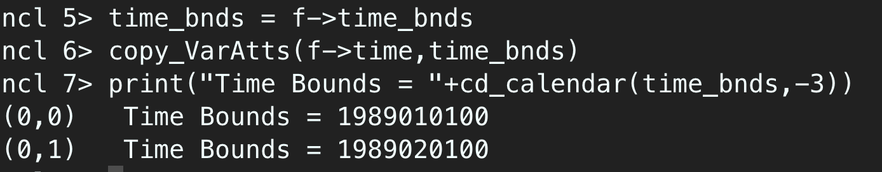
CESM/TaiESM 的垂直座標為
hybrid-sigma coordinate
分析資料時大多需要轉換成氣壓座標
PRS_level = P0*hyam + PS*hybm
NCL : vinth2p, vinth2p_ecmwf
Python : PyNGL, GeoCAT
CESM/TaiESM 的時間是平均區間裡面最後一個時間點

Slide 19
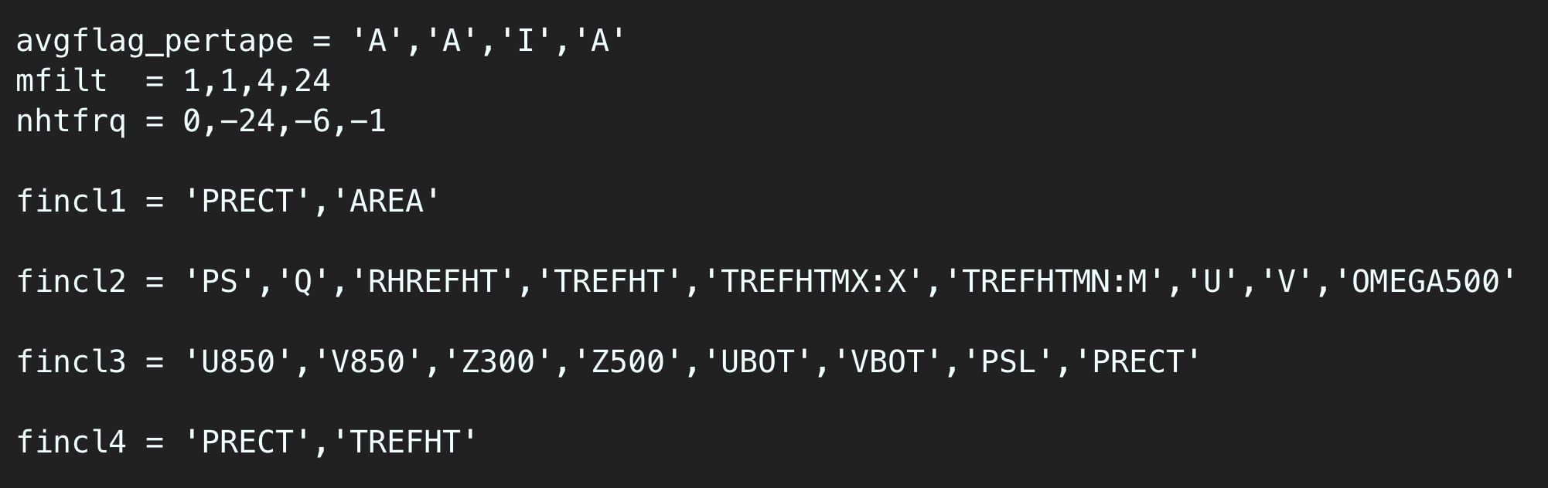
A : Average ; I : instantaneous ; M : Minimum ; X : Maximum
This can be achieved with 3 namelist variables:
mfilt: maximum number of time samples written to a history file
nhtfrq: sets the output frequency
fincl: add variables to the history file
namelist /work1/j07hcl00/ESMClass_2025/namelist/user_nl_cam
Variables List： https://docs.cesm.ucar.edu/models/cam/user-guide/6/hist_flds_fv_cam5.html

Slide 20
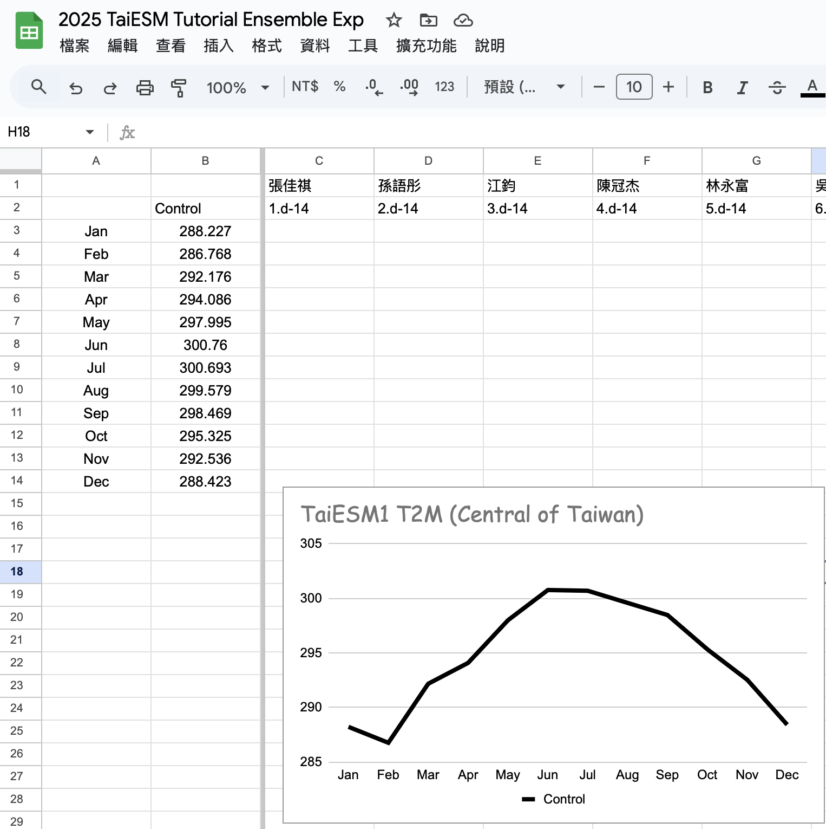
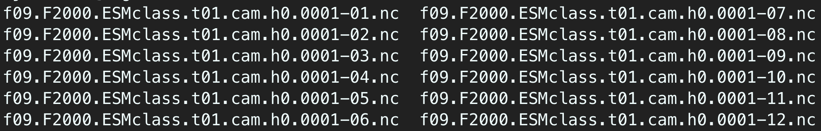
課堂練習二 更改模擬長度 以及 製作系集成員 (Ensemble Member)
資料位置：
/work1/{帳號}/taiesm_work/archive/f09.F2000.ESMclass.t01/atm/hist
取出數值之後並且上傳到google sheet (https://pse.is/7znkd3)
module use /home/j07cyt00/codecs/modulefiles
module load rcec/tools
ncrcat -h -v TREFHT f09.F2000.ESMclass.t02/atm/hist/*.nc t2m.nc
cdo output -remapnn,lon=120.97361_lat=23.97556 t2m.nc

Slide 21
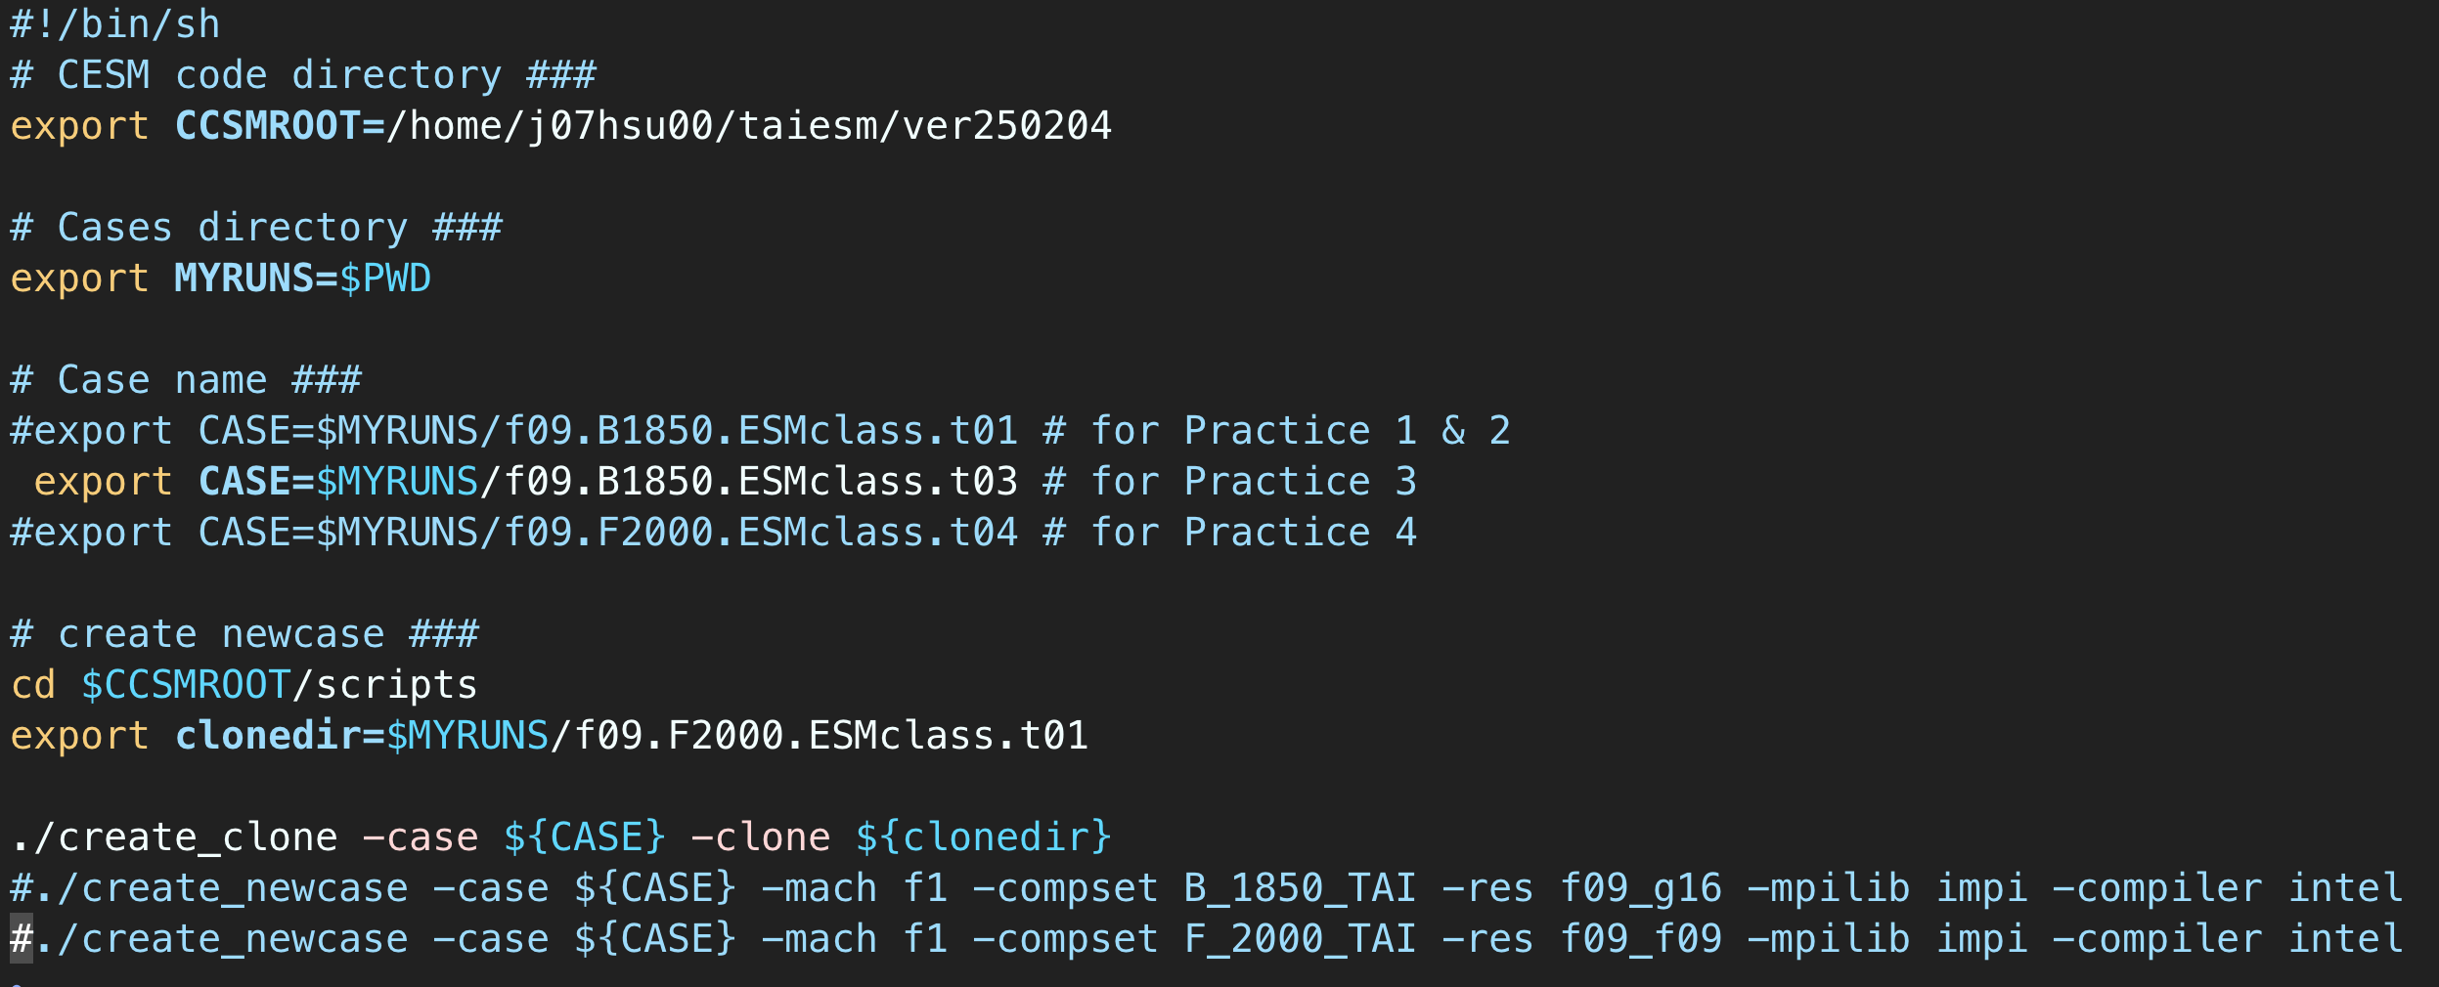
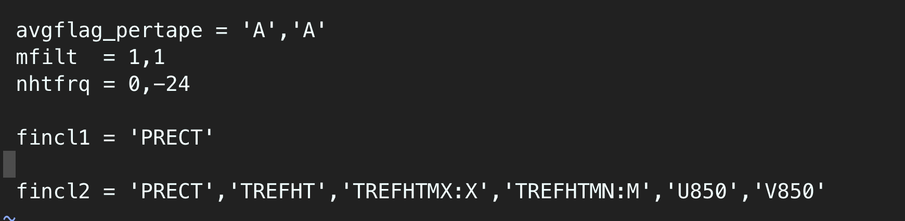
課堂練習三 (clone + branch run) 延續練習一的模擬，要多輸出daily output的變數
使用clone，利用練習一的restart file，/work1/{帳號}/taiesm_work/archive/f09.F2000.ESMclass.t01/rest/0001-01-06-00000
將裡面所有檔案複製到新的資料夾裡面
增加daily 輸出，模擬五天. 需要有最高溫、最低溫、降水
user_nl_cam : /work1/j07hcl00/ESMClass_2025/namelist/user_nl_cam
將run_taiesm1_example.sh裡面的export clonedir & create_clone 這兩行打開，並且取一個clone case的實驗名稱，接者執行
./cesm_setup
修改env_run.xm. a. RUN_TYPE -> branch b. RUN_REFCASE -> f09.F2000.ESMclass.t01 c. RUN_REFDATE -> 0002-01-01 d. STOP_OPTION -> ndays e. STOP_N -> 5
./f09.F2000.ESMclass.t02.build
./f09.F2000.ESMclass.t02.submit

Slide 22
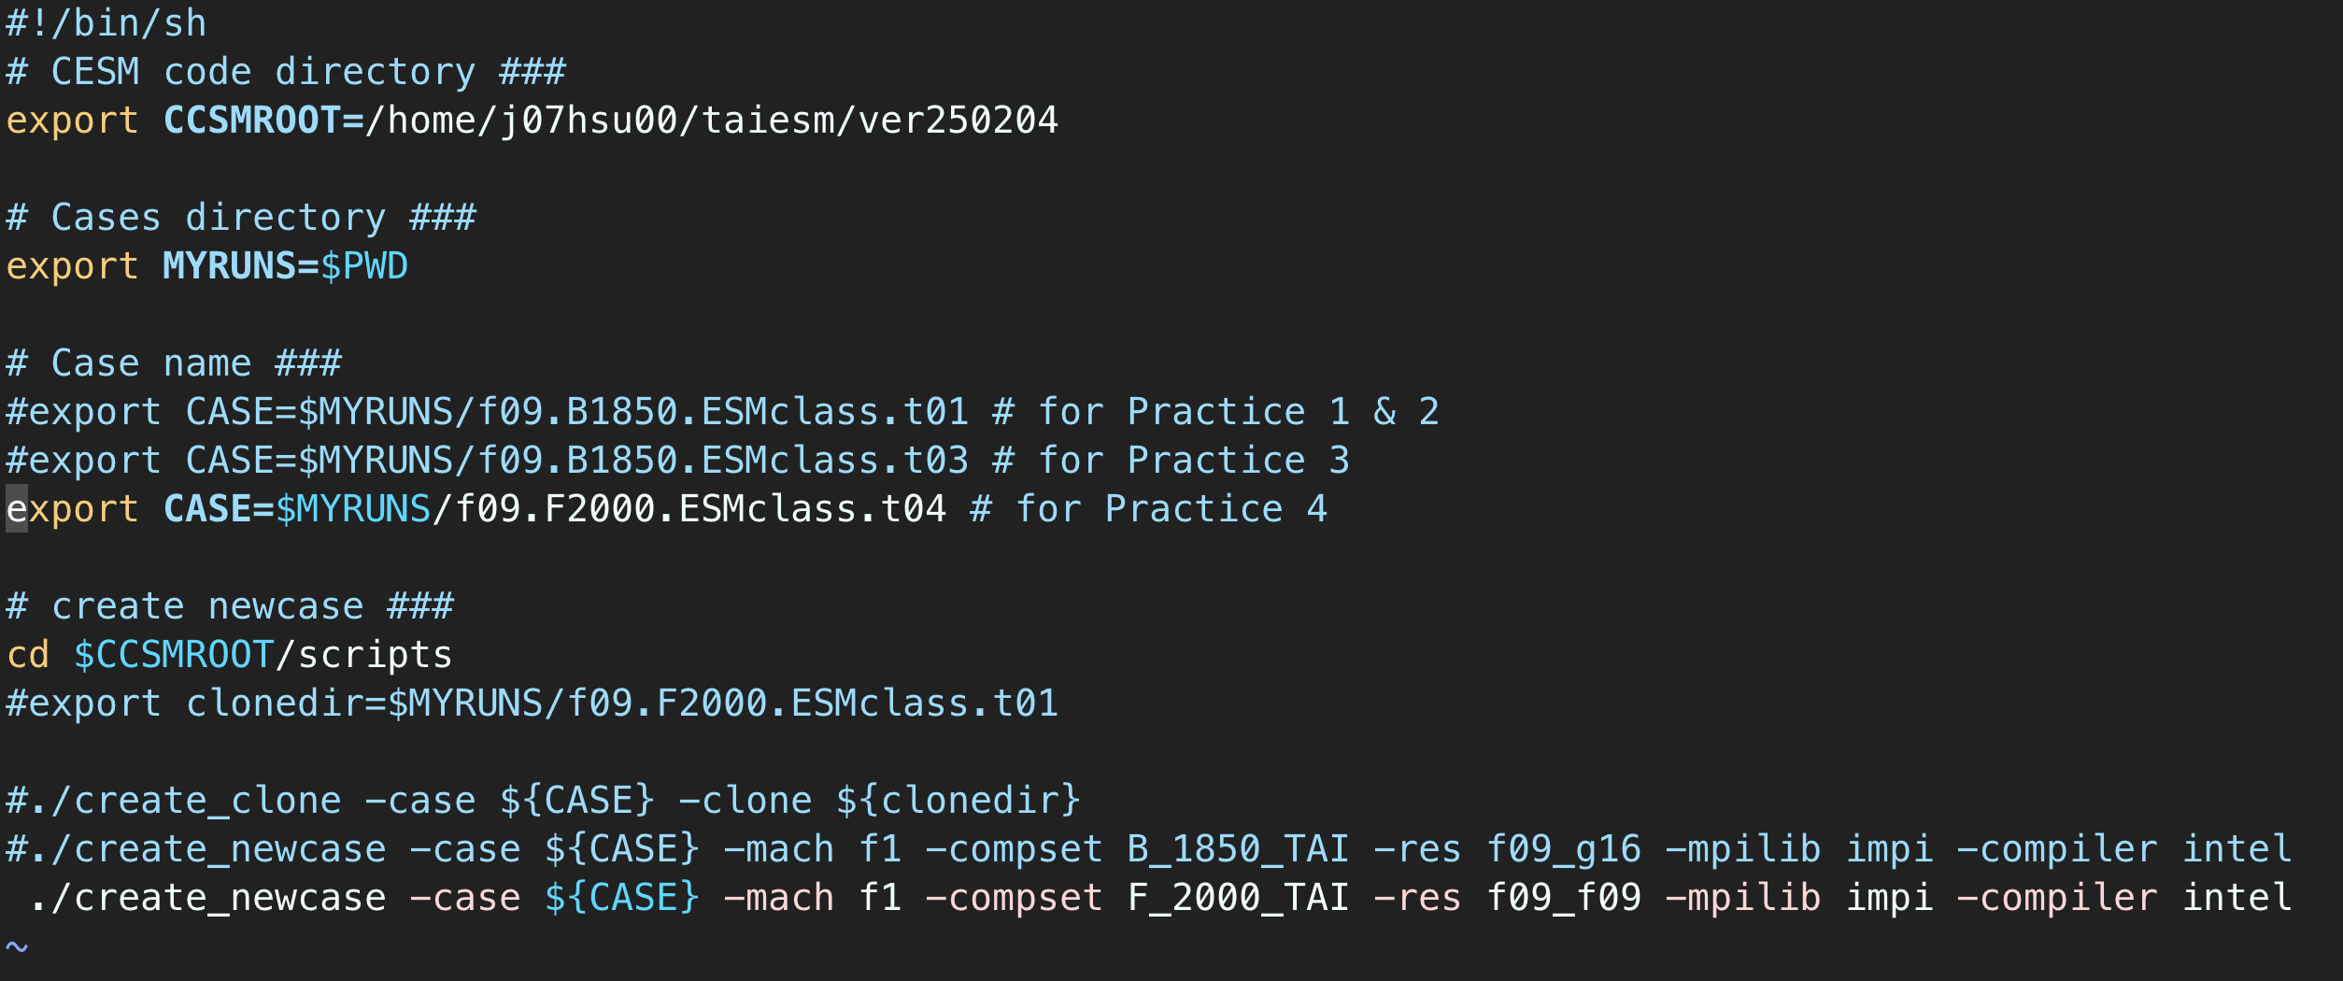
課堂練習四
做AMIP-type 模擬，用氣候平均值的海溫來模擬(只有季節變化，沒有年際變化)
使用F_2000_TAI，使用課堂練習三的user_nl_cam，模擬兩個月，中間需要resubmit一次。
執行run_taiesm1_example.sh
./cesm_setup
修改env_run.xm.l a. STOP_OPTION -> nmonths b. STOP_N -> 1 c. RESUBMIT -> 1
複製 ../f09.F2000.ESMclass.t03/user_nl_cam
4. ./f09.F2000.ESMclass.t04.build
5. ./f09.F2000.ESMclass.t04.submit

